Slide 1


Autonomous car
Group : D58
Group members
Youssef Medhat, Serag Alaa

Slide 2
Hardware Components
Atmega32
Motor driver (L293D) to control the movement and direction of the car.
Ultrasonic sensors for obstacle detection..
servo motor.
Caster wheel.
Chassis
LCD

Slide 3
1
Interfacing
2
Power Distribution
The ATmega32 microcontroller forms a powerful bond with the ultrasonic sensor, servo motor, and motor driver, creating a symphony of data exchange and control.
The L293D motor driver takes charge like a conductor, delivering the perfect blend of power and control signals to the two motors for harmonious movement.
Connections
Ultrasonic sensor (timer0)
Servo motor (timer1)
Motors (Port C Pins from 2 to 5)
LCD (Port A) - 4-bit mode

Slide 4
Timer Modes of Operation
1. Timer 0
Timer 0 is a vital component in our autonomous car project. It operates in normal mode, with a prescaler of 64. This setting allows us to accurately calculate the distance between the car and obstacles in its path.
The timer works in conjunction with the ultrasonic sensor, which emits sound waves and measures the time it takes for the waves to bounce back. By using the prescaler value of 64, we can ensure that the timing is precise and reliable.
This information is crucial for our navigation algorithm, which relies on accurate distance measurements to make informed decisions about the car's movements. By utilizing Timer 0 and the ultrasonic sensor, we can ensure that our autonomous car operates safely and efficiently.

Slide 5
2. Timer 1
plays a crucial role in our autonomous car project. It is configured in PWM mode (mode 14) with a prescaler of 64. This setup allows us to generate the necessary control signals for the servo motor, which is responsible for steering the car based on sensor feedback.
By utilizing the power of Timer 1, we can precisely control the position of the servo motor, enabling smooth and accurate steering adjustments. The prescaler value of 64 ensures that the timing of the control signals is precise, resulting in responsive and reliable steering performance.
This integration between Timer 1 and the servo motor is essential for our autonomous car's navigation. It allows the car to make precise and timely steering corrections based on the information gathered from the sensors, ensuring safe and efficient operation.

Slide 6
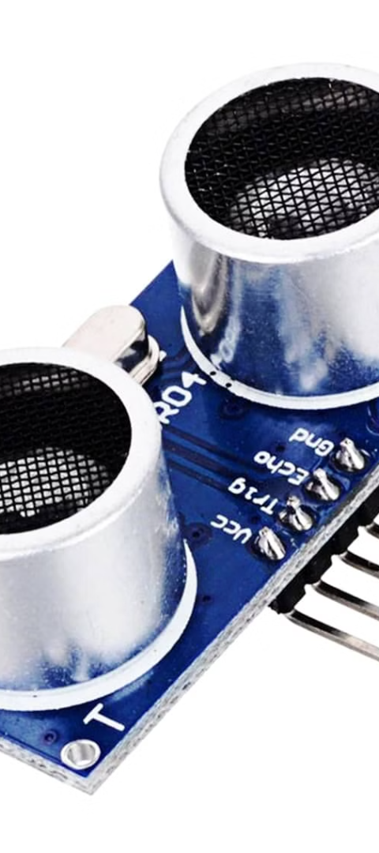
Ultrasonic Sensor Calculations
1
Speed of Sound
2
Distance Calculation
The speed of sound in air, approximately 34300 cm/s, is a crucial factor in the distance calculation performed by the sensor.
timer 0 measures the time-of-flight of the ultrasonic waves to calculate the distance to nearby objects, enabling the car to navigate safely.
3
Distance Equation
4
Real-time Adaptation
distance in cm = 1/2 × 34300 × 64/16000000
The car's control system continuously adjusts its movements based on the real-time data from the ultrasonic sensor, enabling adaptive and responsive navigation.
=0.0686
distance = ((num. of ovf ×256)+TCNT0) × 0.0686

Slide 7
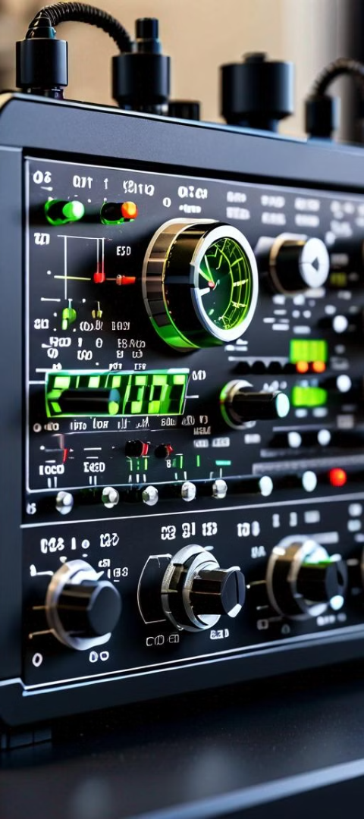
Ultrasonic Sensor Calculations
1
Frequency adjust
2
PWM Mode Configuration
The target frequency for Timer 1 is set to 50 Hz to ensure precise control signals.
Timer 1 is configured in PWM mode (mode 14) to generate control signals for the servo motor.
3
Prescaler Adjustment
4
Frequency equation
The prescaler value of 64 is implemented to maintain accurate timing for frequency control.
freq= Fclk/N.(1+top)
freq=16000000/64(1+4999)
freq=50Hz

Slide 8



Navigation Algorithm
Sensor Monitoring
Path Planning
Continuous Adaptation
The car continuously monitors the ultrasonic sensor data to detect the presence and distance of nearby objects.
Based on the sensor data, the car's control system determines the optimal path to navigate and avoid obstacles.
The navigation algorithm continuously loops, adjusting the car's movements in real-time to ensure safe and efficient autonomous operation.

Slide 9
thank you

